Slide 1
URINARY TRACT INFECTION IN CHILDREN By Dr.Mahadevi A.L Assistant Professor Dept of Paediatrics 10-08-2021

Slide 3
A urinary tract infection (UTI) in children is a fairly common condition.
Bacteria that enter the urethra are usually flushed out through urination. However, when bacteria aren’t expelled out of the urethra, they may grow within the urinary tract. This causes an infection.
The urinary tract consists of the parts of the body that are involved in urine production. They are:
two kidneys that filter your blood and extra water to produce urine
two ureters, or tubes, that take urine to your bladder from your kidneys
a bladder that stores your urine until it’s removed from your body
a urethra, or tube, that empties urine from your bladder to outside your body

Slide 4
child can develop a UTI when bacteria enter the urinary tract and travel up the urethra and into the body.
The two types of UTIs most likely to affect children are bladder infections and kidney infections.
When a UTI affects the bladder, it’s called cystitis.
When the infection travels from the bladder to the kidneys, it’s called Pyelonephritis.
Both can be successfully treated with antibiotics, but a kidney infection can lead to more serious health complications if left untreated.

Slide 5
Causes:
UTIs are most commonly caused by bacteria, which may enter the urinary tract from the skin around the anus or vagina.
The most common cause of UTIs is E. coli, which originates in the intestines.
Most UTIs are caused when this type of bacteria or other bacteria spread from the anus to the urethra.

Slide 6
Risk Factors for Urinary Tract Infection
Female gender
Uncircumcised male
Vesicoureteral reflux
Toilet training
Voiding dysfunction
Obstructive uropathy
Urethral instrumentation
Sources of external irritation (such as tight clothing, pinworm infestation)
Constipation
Anatomic abnormality (labial adhesion)
Neuropathic bladder
Sexual activity
Pregnancy

Slide 8
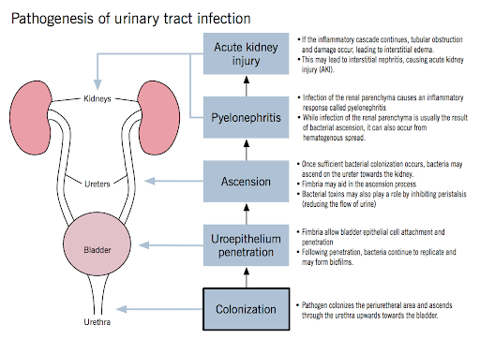

Slide 9
Symptoms of UTI in children
Symptoms of a UTI can vary depending on the degree of infection and your child’s age. Infants and very young children may not experience any symptoms. When they do occur in younger children, symptoms can be very general. They may include:
fever
poor appetite
vomiting
diarrhea
irritability
overall feeling of illness

Slide 10
Additional symptoms vary depending on the part of the urinary tract that’s infected.
If child has a bladder infection, symptoms may include:
blood in the urine
cloudy urine
foul-smelling urine
pain, stinging, or burning with urination
pressure or pain in the lower pelvis or lower back, below the navel
frequent urination waking from sleep to urinate
feeling the need to urinate with minimal urine output
urine accidents after the age of toilet training

Slide 11
If the infection has traveled to the kidneys, the condition is more serious. The child may experience more intense symptoms, such as:
irritability
chills with shaking
high fever
skin that’s flushed or warm
nausea and vomiting
side or back pain
severe abdominal pain
severe fatigue

Slide 12
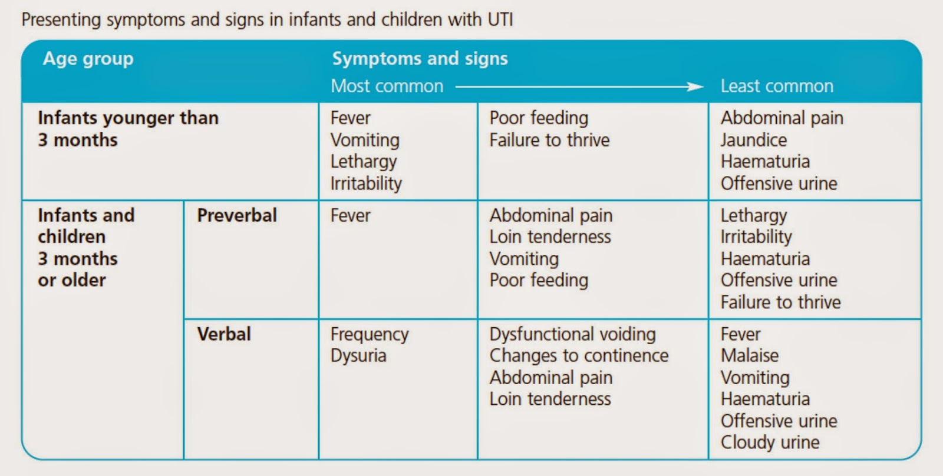

Slide 13
Diagnosis of UTI in children
A urine sample is required to make an accurate diagnosis.
The sample may be used for:
Urinalysis. Urine is tested with a special test strip to look for signs of infection such as blood and white blood cells.
In addition, a microscope may be used to examine the sample for bacteria or pus.
Urine culture. This laboratory test usually takes 24 to 48 hours.
The sample is analyzed to identify the type of bacteria causing the UTI, how much of it exists, and appropriate antibiotic treatment.

Slide 14
Collecting a clean urine sample can be a challenge for children who aren’t toilet trained. A usable sample can’t be obtained from a wet diaper.
Urine collection bag. A plastic bag is taped over child’s genitals to collect the urine.
Catheterized urine collection. A catheter is inserted into the tip of a boy’s penis or into a girl’s urethra and into the bladder to collect urine. This is the most accurate method.

Slide 15
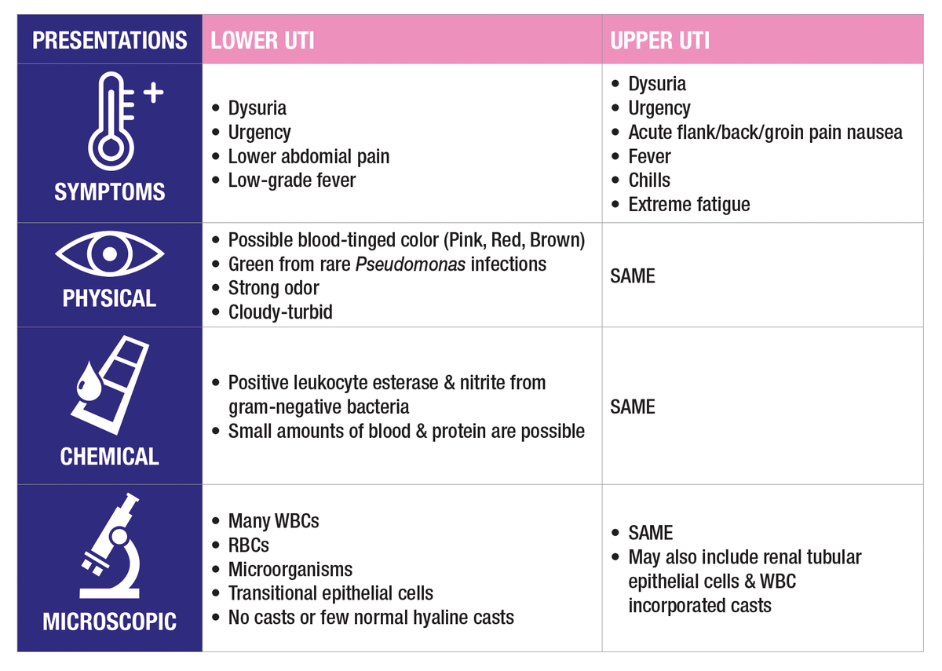

Slide 16
Additional tests
physician may recommend additional diagnostic tests to determine whether the source of the UTI is caused by an abnormal urinary tract.
If the child has a kidney infection, tests also may be required to look for kidney damage. The following imaging tests may be used:
kidney and bladder ultrasound
voiding cystourethrogram (VCUG)
nuclear medicine renal scan (DMSA)
CT scan or MRI of the kidneys and bladder

Slide 17
A VCUG is an X-ray that’s taken while child’s bladder is full. The doctor will inject a contrast dye into the bladder and then have your child urinate — typically through a catheter — to observe how the urine flows out of the body. This test can help detect any structural abnormalities that may be causing a UTI, and whether vesicoureteral reflux occurs.
A DMSA is a nuclear test in which pictures of the kidneys are taken after the intravenous (IV) injection of a radioactive material called an isotope.
The tests may be done while your child has the infection. Often, they’re done weeks or months after treatment to determine if there’s any damage from the infection.

Slide 18
Complications of UTI in children
Prompt diagnosis and treatment of a UTI in child can prevent serious, long-term medical complications.
Untreated, a UTI can result in a kidney infection that may lead to more serious conditions, such as:
kidney abscess
reduced kidney function or kidney failure
hydronephrosis, or swelling of the kidneys
sepsis, which can lead to organ failure and death

Slide 19
Treatment of UTI in children
Your child’s UTI will require prompt antibiotic treatment to prevent kidney damage. The type of bacteria causing your child’s UTI and the severity of your child’s infection will determine the type of antibiotic used and the length of treatment.
The most common antibiotics used for treatment of UTIs in children are:
amoxicillin
amoxicillin and clavulanic acid
cephalosporins

Slide 20
cephalosporins
doxycycline, but only in children over age 8
nitrofurantoin
sulfamethoxazole-trimethoprim
If your child has a UTI that’s diagnosed as a simple bladder infection, it’s likely that treatment will consist of oral antibiotics at home.
However, more severe infections may require hospitalization and IV fluids or antibiotics

Slide 21
Hospitalization may be necessary in cases where the child:
is younger than 6 months old
has a high fever that isn’t improving
likely has a kidney infection, especially if the child is very ill or young
has a blood infection from the bacteria, as in sepsis
dehydrated, vomiting, or unable to take oral medications for any other reason

Slide 22
Pain medication to alleviate severe discomfort during urination also may be prescribed.
If your child is receiving antibiotic treatment at home, you can help ensure a positive outcome by taking certain steps.

Slide 23
During the child’s treatment, contact their doctor if symptoms worsen or persist for more than three days.
Also call their doctor if your child has:
a fever higher than 101˚F (38.3˚C)
for infants, a new or persisting (lasting more than three days) fever higher than 100.4˚F (38˚C)
should also seek medical advice if the child develops new symptoms, including:
pain
vomiting
rash
swelling
changes in urine output

Slide 24
Long-term outlook for children with a UTI
With prompt diagnosis and treatment, you can expect your child to fully recover from a UTI.
However, some children may require treatment for periods lasting from six months up to two years.
Long-term antibiotic treatment is more likely if child receives a diagnosis of vesicoureteral reflex, or VUR. This birth defect results in the abnormal backward flow of urine from the bladder up the ureters, moving urine toward the kidneys instead of out the urethra.
This disorder should be suspected in young children with recurring UTIs or any infant with more than one UTI with fever.

Slide 25
Children with VUR have a higher risk of kidney infection due to the VUR. It creates an increased risk of kidney damage and, ultimately, kidney failure.
Surgery is an option used in severe cases. Typically, children with mild or moderate VUR outgrow the condition. However, kidney damage or kidney failure may occur into adulthood.

Slide 26
UTI Prevention
Don’t give female children bubble baths. They can allow bacteria and soap to enter the urethra.
Avoid tight-fitting clothing and underwear for the child, especially girls.
Ensure that the child drinks enough fluids.
Avoid allowing the child to have caffeine, which can cause bladder irritation.
Change diapers frequently in younger children.
Teach older children proper hygiene for maintaining a clean genital area.
Encourage the child to use the bathroom frequently rather than holding in urine.
Teach the child safe wiping techniques, especially after bowel movements. Wiping from front to back reduces the likelihood that bacteria from the anus will get transferred into the urethra.

Slide 27
If your child gets repeated UTIs, preventive antibiotics are sometimes advised.
However, they haven’t been found to decrease recurrence or other complications. Be sure to follow the instructions even if your child doesn’t have symptoms of a UTI.
Urinary tract infections affect millions of people every year.
Though they’re traditionally treated with antibiotics, there are also many home remedies available that help treat them and prevent them from reoccurring.

Slide 28
1. Drink Plenty of Fluids
Hydration status has been linked to the risk of urinary tract infection.
This is because regular urination can help flush bacteria from the urinary tract to prevent infection.
One study examined participants with long-term urinary catheters and found that low urine output was associated with an increased risk of developing a UTI.
A 2003 study looked at 141 girls and showed that low fluid intake and infrequent urination were both linked to recurrent UTIs.

Slide 29
2. Increase Vitamin C Intake
Some evidence shows that increasing intake of vitamin C could protect against urinary tract infections.
Vitamin C is thought to work by increasing the acidity of the urine, thereby killing off the bacteria that cause infection .
The study found that vitamin C had a protective effect, cutting the risk of UTIs by more than half in those taking vitamin C compared to the control group .
Another study looked at behavioral factors that affected the risk of UTIs and found that a high vitamin C intake decreased the risk .

Slide 30
Fruits and vegetables are especially high in vitamin C and are a good way to increase your intake.
Red peppers, oranges, grapefruit and kiwifruit all contain the full recommended amount of vitamin C in just one serving .
Increasing vitamin C intake may decrease the risk of UTIs by making the urine more acidic, thus killing off infection-causing bacteria.

Slide 31
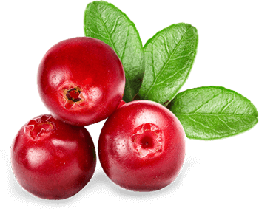
3. Drink Unsweetened Cranberry Juice
Drinking unsweetened cranberry juice is one of the most well-known natural remedies for urinary tract infections.
Cranberries work by preventing bacteria from adhering to the urinary tract, thus preventing infection.
In one recent study, women with recent histories of UTIs drank an 8-ounce (240-ml) serving of cranberry juice every day for 24 weeks. Those who drank cranberry juice had fewer UTI episodes than the control group .
Another study showed that consuming cranberry products may lower the number of UTIs in a year, especially for women who have recurrent UTIs .

Slide 32
4. Take a Probiotic
Probiotics are beneficial microorganisms that are consumed through food or supplements. They can promote a healthy balance of bacteria in the gut.
Probiotics are available in supplement form or can be found in fermented foods, such as kefir, kimchi, kombucha and probiotic yogurt.
The use of probiotics has been linked to everything from improved digestive health to enhanced immune function
Some studies also show that certain strains of probiotics may decrease the risk of UTIs.
One study found that Lactobacillus, a common probiotic strain, helped prevent UTIs in adult .
Probiotics could help prevent UTIs when used alone or in combination with antibiotics.

Slide 33
5. Practice These Healthy Habits
Preventing urinary tract infections starts with practicing a few good bathroom and hygiene habits.
First, it’s important not to hold urine for too long. This can lead to a buildup of bacteria, resulting in infection.
Finally, when use the toilet, make sure wipe front to back. Wiping from back to front can cause bacteria to spread to the urinary tract and is associated with an increased risk of UTIs.

Slide 34
Natural Supplements
Several natural supplements may decrease the risk of developing a UTI.
D-Mannose: This is a type of sugar that is found in cranberries and has been shown to be effective in treating UTIs and preventing recurrence.
Bearberry leaf: Also known as uva-ursi. One study showed that a combination of bearberry leaf, dandelion root and dandelion leaf decreased UTI recurrence.
Cranberry extract: Like cranberry juice, cranberry extract works by preventing bacteria from adhering to the urinary tract.
Garlic extract: Garlic has been shown to have antimicrobial properties and may be able to block the growth of bacteria to prevent UTIs.

Slide 35
HOMOEOPATHIC MANAGEMENT
Cantharis
Intolerable urging and tenesmus. Nephritis with bloody urine.
Violent paroxysms of cutting and burning in whole renal region, with painful urging to urinate; bloody urine, by drops.
Intolerable tenesmus; cutting before, during, and after urine.
Urine scalds him, and is passed drop by drop.
Constant desire to urinate.
Membranous scales looking like bran in water. Urine jelly-like, shreddy.

Slide 36
Borax
Hot, smarting pain in orifice. Pungent smell. Child afraid to urinate, screams before urinating (Sarsap). Small red particles on diaper.
Sarsaparilla
Urine scanty, slimy, flaky, sandy, bloody. Gravel. Renal colic. Severe pain at conclusion of urination. Urine dribbles while sitting. Bladder distended and tender. Child screams before and while passing urine. Sand on diaper. Renal colic and dysuria in infants. Pain from right kidney downward. Tenesmus of bladder; urine passes in thin, feeble stream. Pain at meatus.

Slide 37
Lycopodium
Pain in back before urinating; ceases after flow; slow in coming, must strain. Retention. Polyuria during the night. Heavy red sediment. Child cries before urinating (Bor).
Nux vomica
Irritable bladder; from spasmodic sphincter. Frequent calls; little and often. Hæmaturia (Ipec; Tereb). Ineffectual urging, spasmodic and strangury. Renal colic extending to genitals, with dribbling urine. While urinating, itching in urethra and pain in neck of bladder.

Slide 38
Apis mellifica
Burning and soreness when urinating. Suppressed, loaded with casts; frequent and involuntary; stinging pain and strangury; scanty, high colored. Incontinence. Last drops burn and smart.
Petroselenium
Burning, tingling, from perineum throughout whole urethra; sudden urging, to urinate; frequent, voluptuous tickling in fossa navicularis. Gonorrhśa; sudden, irresistible desire to urinate; intense biting, itching, deep in urethra; milky discharge.
Terebinth
Strangury, with bloody urine. Scanty, suppressed, odor of violets. Urethritis, with painful erections (Canthar). Inflamed kidneys following any acute disease. Constant tenesmus.

Slide 40
Thank you

